Slide 1
TNSDC-Generative AI
Image classification using Deep learning and CNN
Presented by : Ajay.S ,
au211521104004,
Pre-Final Student,
Computer Science and Engineering,
Panimalar Institute of Technology.

Slide 2

OUTLINE
Problem Statement
Proposed Solution
System Approach
Algorithm
Result
Conclusion
References

Slide 3
PROBLEM STATEMENT
The problem statement of image classification using deep learing is The task is to develop a deep learning model for image classification that can accurately classify input images into predefined categories or labels. The categories could range from simple distinctions like identifying whether an image contains a cat or a dog, to more complex tasks like classifying different types of vehicles or identifying specific objects in medical images.

Slide 4
PROPOSED SOLUTION
There are several approaches to image classification using deep learning Image classification is a cornerstone of computer vision and plays a crucial role in various fields. This paper pays close attention to some traditional deep-learning approaches to image classification. Although traditional approaches, including traditional machine learning approaches, are initially practical for image classification for handcrafted feature extraction methods, they still have many limitations, such as poor scalability. These limitations limit their development. Thus, deep learning approaches have been explored, symbolizing a significant step forward in the quest for automated visual understanding. Deep learning approaches, particularly CNNs, can automatically learn and present features from raw data. They are suitable for a wide range of image classification tasks. Like any other approach, deep learning approaches have flaws, too. In addition, datasets have been instrumental in benchmarking the capabilities of algorithms, and the transfer learning approaches have positively impacted image classification models. In short, challenges have always existed, and innovation needs persistence to create a better future.

Slide 5
SYSTEM APPROACH
Hardware:
CPU: The system requires a CPU with sufficient processing power to handle the computational demands of Convolutional Neural Network (CNN) training and inference. A multi-core processor, preferably with a clock speed of at least 2 GHz or higher, is recommended.
Memory: A minimum of 8 GB RAM is recommended for smooth operation, especially during model training, where large datasets are processed. More RAM may be required for handling larger datasets or concurrent user requests.
Internet Speed: A stable internet connection is necessary for downloading and updating Python packages, model weights, and serving the web application. A broadband connection with a minimum download speed of 5 Mbps and upload speed of 1 Mbps is sufficient for most purposes.
Software:
Python: The system is built using Python programming language

Slide 6

ALGORITHM
Phase 1: Data Preparation and Preprocessing
Collect a diverse and representative dataset for the image classification task. This dataset should include a variety of images belonging to different categories.
Preprocess the images by resizing them to a uniform size, normalizing pixel values, and augmenting the data to increase variability (e.g., rotation, flipping, zooming).
Phase 2: Model Training
Split the dataset into training, validation, and testing sets (e.g., 70% for training, 15% for validation, and 15% for testing).
Use transfer learning techniques if a pre-trained model is employed. Otherwise, train the model from scratch.
Define appropriate loss functions (e.g., categorical cross-entropy), optimizer (e.g., Adam, SGD), and learning rate schedules for training the model.
Train the model using the training dataset and monitor its performance on the validation set to prevent overfitting.

Slide 7
ALGORITHM - CONT.
Phase 3: Hyperparameter Tuning
Conduct hyperparameter tuning experiments to optimize the model's performance. This may include adjusting learning rates, batch sizes, dropout rates, and regularization techniques.
Utilize techniques like grid search, random search, or Bayesian optimization to find the optimal hyperparameters efficiently.
Phase 4: Model Deployment
Once satisfied with the model's performance, save the trained model weights and architecture for deployment.
Create a user-friendly interface or API for users to upload images and receive classification results.
Deploy the model on a suitable platform (e.g., cloud service, edge device) considering factors like scalability, latency, and security.

Slide 8
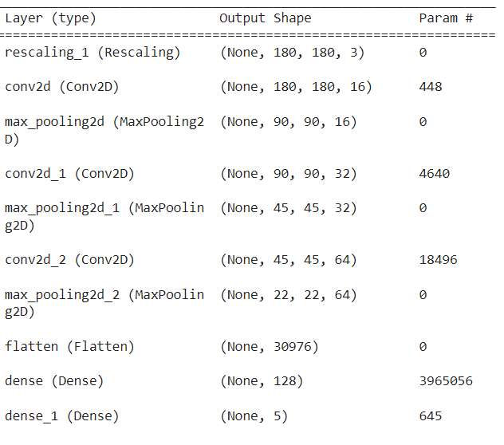
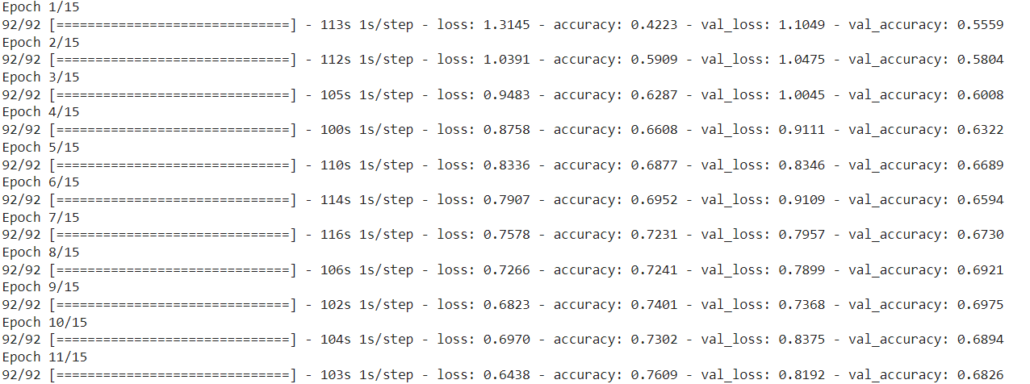
RESULT

Slide 9
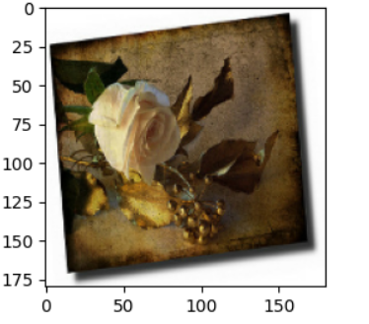
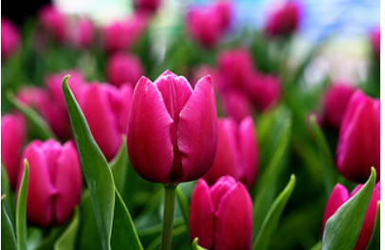
RESULT CONT.

Slide 10
Conclusion
In conclusion, image classification using deep learning has emerged as a powerful and versatile tool with a wide range of applications across various domains. Through the development and implementation of deep learning models, such as convolutional neural networks (CNNs), significant progress has been made in accurately classifying images and extracting meaningful insights from visual data.Overall, image classification using deep learning represents a significant milestone in computer vision, with continued research and innovation driving its capabilities further. By integrating best practices, cutting-edge technologies, and domain expertise, deep learning models continue to revolutionize image analysis, pattern recognition, and decision-making processes across industries.Four test images sea anemone, barometer, stethoscope and radio in-terferometer are chosen from the AlexNet database for testing and validation of image classification using deep learning. The convolutional neural network is used in AlexNet architecture for classification purpose. From the experiments, it is observed that the im-ages are classified correctly even for theportion of the test images and shows the effectiveness of deep learning algorithm.
9

Slide 11
REFERENCES
[1] https://in.mathworks.com/matlabcentral/fileexchange/59133-
neural-network-toolbox-tm--model-for-alexnet-network
[2] H. Lee, R. Grosse, R. Ranganath, and A.Y. Ng. Convolutional
deep belief networks for scalable unsupervised learning of hierar-
chical representations. In Proceedings of the 26th Annual Interna-
tional Conference on Machine Learning, pages 609–616. ACM,
2009
[3] Deep Learning with MATLAB – matlab expo2018
[4] Introducing Deep Learning with the MATLAB – Deep Learning
E-Book provided by the mathworks.
[5] https://www.completegate.com/2017022864/blog/deep-machine-
learning-images-lenet-alexnet-cnn/all-pages
10

